Slide 1
Sorting I

Slide 2
Recap – Previous Lecture
Algorithms complexity
Big O notation

Slide 3
This Lecture
Sort an array by swapping
Big O notation of Sorting Algorithms
O(n²) Sorts
  Bubble Sort
  Selection Sort
  Insertion Sort

Slide 4
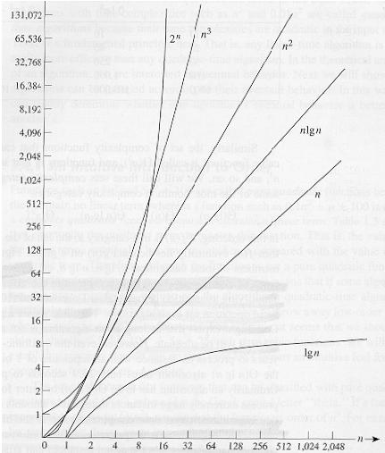
This Lecture
Bubble sort
Selection sort
Insertion sort
sorting time
BST search
AVL search
number elements

Slide 5
This Lecture
Sort an array by swapping
Big O notation of Sorting Algorithms
O(n²) Sorts
  Bubble Sort
  Selection Sort
  Insertion Sort
  There is no perfect sorting algorithm
  (depends on inputs)

Slide 6
Sort
32 | 65 | 13 | 56 | 76 | 2 | 38

Slide 7
Sort
32 | 65 | 13 | 56 | 76 | 2 | 38
2 | 13 | 32 | 38 | 56 | 65 | 76

Slide 8
Sort
32 | 65 | 13 | 56 | 76 | 2 | 38
2 | 13 | 32 | 38 | 56 | 65 | 76
not only numbers, you can sort “anything”
(int, strings, your own data type..)

Slide 9
Swap
10
20
A B temp
Swap values of variables A and B (using temp variable)

Slide 10
Swap
10
20
10
A B temp
Swap values of variables A and B (using temp variable)
First copy the value of A inside Temp

Slide 11
Swap
20
20
10
A B temp
Swap values of variables A and B (using temp variable)
First copy the value of A inside Temp
Copy value of variable B inside variable A.

Slide 12
Swap
20
10
10
A B temp
Swap values of variables A and B (using temp variable)
First copy the value of A inside Temp
Copy value of variable B inside variable A.
Copy value of variable Temp inside variable B

Slide 13
Swap
20
10
10
A B temp
Swap values of variables A and B (using temp variable)
First copy the value of A inside Temp
Copy value of variable B inside variable A.
Copy value of variable Temp inside variable B
Values have been exchanged: variable A contains 20 and variable B contains 10.

Slide 14
Swap Code
static void swap(int x, int y)
{
}
int a = 93; int b = 44;
swap(a, b);
2nd
x
1st
y
3nd
temp

Slide 15
Swap Code
static void swap(int x, int y)
{
int temp = x;
x = y;
y = temp;
}
int a = 93; int b = 44;
swap(a, b);
2nd
x
1st
y
3nd
temp

Slide 16
Swap Code
static void swap(int x, int y)
{
int temp = x;
x = y;
y = temp;
}
int a = 93; int b = 44;
swap(a, b);
a = ? b = ?
2nd
x
1st
y
3nd
temp

Slide 17
Swap Code
static void swap(int x, int y)
{
int temp = x;
x = y;
y = temp;
}
int a = 93; int b = 44;
swap(a, b);
a = 93 b = 44
2nd
x
1st
y
3nd
temp

Slide 18
Swap Code
static void swap(ref int x, ref int y)
{
int temp = x;
x = y;
y = temp;
}
int a = 93; int b = 44;
swap(ref a, ref b);
a = 44, b =93
2nd
x
1st
y
3nd
temp

Slide 19

Bubble Sort
Idea: larger elements in an array gradually move towards the end of the array, just like bubbles rising in a glass of water!

Slide 20
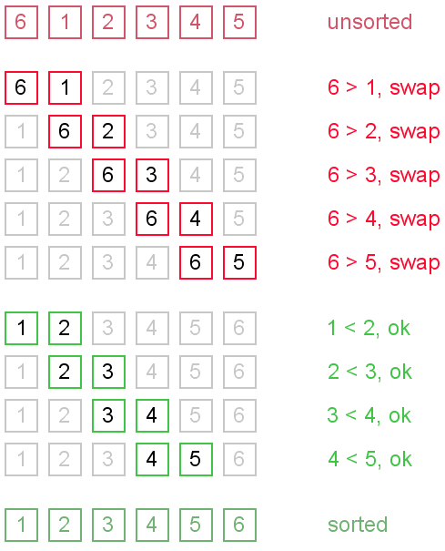
Bubble Sort

Slide 21
Bubble Sort
How many times should I
iterate over the array ?

Slide 22
Bubble Sort
static void NaiveBubbleSort(int[] numbers)
{
bool swapped = true;
while(swapped)
{
// iterate over the array and swap
// use a Boolean variable (swapped)
// to check if there was any swap
} // while
}

Slide 23
Bubble Sort
static void NaiveBubbleSort(int[] numbers)
{
bool swapped = true;
while(swapped)
{
swapped = false;
for (int i =0; i < numbers.Length - 1; i++)
{
if (numbers[i] > numbers[i + 1])
{
swap(ref numbers[i],ref numbers[i+1]);
swapped =true;
} // if
} // for
} // while
}

Slide 24
Bubble Sort
static void NaiveBubbleSort(int[] numbers)
{
bool swapped = true;
while(swapped)
{
swapped = false;
for (int i =0; i < numbers.Length - 1; i++)
{
if (numbers[i] > numbers[i + 1])
{
swap(ref numbers[i],ref numbers[i+1]);
swapped =true;
} // if
} // for
} // while
}
can this be
improved?

Slide 25
Modified Bubble Sort
static void BubbleSort(int[] numbers)
{
bool swapped = true;
int upper = numbers.Length - 1;
while (swapped)
{
swapped = false;
for (int i = 0; i < upper; i++)
{
if (numbers[i] > numbers[i + 1])
{
swap(ref numbers[i], ref numbers[i + 1]);
swapped = true;
} // if
} // for
--upper;
} // while
}
more efficient

Slide 26
Bubble Sort Example
10, 34, 2, 16, 23, 8, 12.
i=0
upper

Slide 27
Bubble Sort Example
10, 34, 2, 16, 23, 8, 12.
ok, no swap

Slide 28
Bubble Sort Example
10, 34, 2, 16, 23, 8, 12.
not ok, swap

Slide 29
Bubble Sort Example
10, 2, 34, 16, 23, 8, 12.

Slide 30
Bubble Sort Example
10, 2, 34, 16, 23, 8, 12.
not ok, swap

Slide 31
Bubble Sort Example
10, 2, 16, 34, 23, 8, 12.

Slide 32
Bubble Sort Example
10, 2, 16, 34, 23, 8, 12.
not ok, swap

Slide 33
Bubble Sort Example
10, 2, 16, 23, 34, 8, 12.

Slide 34
Bubble Sort Example
10, 2, 16, 23, 34, 8, 12.
not ok, swap

Slide 35
Bubble Sort Example
10, 2, 16, 23, 8, 34, 12.

Slide 36
Bubble Sort Example
10, 2, 16, 23, 8, 34, 12.
not ok, swap

Slide 37
Bubble Sort Example
10, 2, 16, 23, 8, 12, 34.
repeat again until no swap
(array is ordered)
upper

Slide 38
Bubble Sort Example
10, 2, 16, 23, 8, 12, 34.
i=0
upper

Slide 39
Bubble Sort Example
10, 2, 16, 23, 8, 12, 34.
not Ok
swap
i=0
upper

Slide 40
Bubble Sort Example
2, 10, 16, 23, 8, 12, 34.
i=0
upper

Slide 41
Bubble Sort Example
2, 10, 16, 23, 8, 12, 34.
Ok
no swap
i=0
upper

Slide 42
Bubble Sort Example
2, 10, 16, 23, 8, 12, 34.
Ok
No
swap
i=0
upper

Slide 43
Bubble Sort Example
2, 10, 16, 23, 8, 12, 34.
not Ok
swap
i=0
upper

Slide 44
Bubble Sort Example
2, 10, 16, 8, 23, 12, 34.
i=0
upper

Slide 45
Bubble Sort Example
2, 10, 16, 8, 23, 12, 34.
not Ok
swap
i=0
upper

Slide 46
Bubble Sort Example
2, 10, 16, 8, 12, 23, 34.
i=0
upper

Slide 47
Bubble Sort Example
2, 10, 16, 8, 12, 23, 34.
i=0
upper

Slide 48
Bubble Sort Example
2, 10, 16, 8, 12, 23, 34.
Ok
no swap
i=0
upper

Slide 49
Bubble Sort Example
2, 10, 16, 8, 12, 23, 34.
Ok
no swap
i=0
upper

Slide 50
Bubble Sort Example
2, 10, 16, 8, 12, 23, 34.
Not ok
swap
i=0
upper

Slide 51
Bubble Sort Example
2, 10, 8, 16, 12, 23, 34.
Not ok
swap
i=0
upper

Slide 52
Bubble Sort Example
2, 10, 8, 16, 12, 23, 34.
Not ok
swap
i=0
upper

Slide 53
Bubble Sort Example
2, 10, 8, 12, 16, 23, 34.
Not ok
swap
i=0
upper

Slide 54
Bubble Sort Example
2, 10, 8, 12, 16, 23, 34.
i=0
upper

Slide 55
Bubble Sort Example
2, 10, 8, 12, 16, 23, 34.
ok
no
swap
i=0
upper

Slide 56
Bubble Sort Example
2, 10, 8, 12, 16, 23, 34.
Not ok
swap
i=0
upper

Slide 57
Bubble Sort Example
2, 8, 10, 12, 16, 23, 34.
Not ok
swap
i=0
upper

Slide 58
Bubble Sort Example
2, 8, 10, 12, 16, 23, 34.
ok
No swap
i=0
upper

Slide 59
Bubble Sort Example
2, 8, 10, 12, 16, 23, 34.
i=0
upper

Slide 60
Bubble Sort Example
2, 8, 10, 12, 16, 23, 34.
i=0
upper
No swap → can stop. Sorted

Slide 61
Selection Sort
another sorting algorithm based on swapping
elements
idea: choose the smallest and move it at the beginning

Slide 62
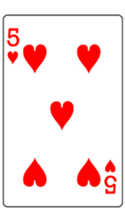
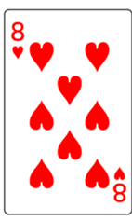
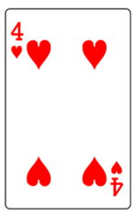
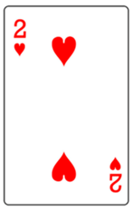
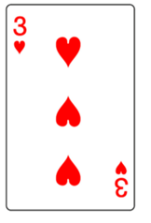
Selection Sort

Slide 63
Selection Sort
smallest

Slide 64
Selection Sort
smallest
swap smallest card with
the card at the beginning

Slide 65
Selection Sort

Slide 66
Selection Sort

Slide 67
Selection Sort
smallest

Slide 68
Selection Sort
smallest

Slide 69
Selection Sort
smallest

Slide 70
Selection Sort
smallest

Slide 71
Selection Sort
sorted

Slide 72
Selection Sort
a = 64, 25, 12, 22, 11

Slide 73
Selection Sort
a = 64, 25, 12, 22, 11

Slide 74
Selection Sort
a = 64, 25, 12, 22, 11
a = 11, 25, 12, 22, 64

Slide 75
Selection Sort
a = 64, 25, 12, 22, 11
a = 11, 25, 12, 22, 64

Slide 76
Selection Sort
a = 64, 25, 12, 22, 11
a = 11, 25, 12, 22, 64

Slide 77
Selection Sort
a = 64, 25, 12, 22, 11
a = 11, 25, 12, 22, 64
a = 11, 12, 25, 22, 64

Slide 78
Selection Sort
a = 64, 25, 12, 22, 11
a = 11, 25, 12, 22, 64
a = 11, 12, 25, 22, 64

Slide 79
Selection Sort
a = 64, 25, 12, 22, 11
a = 11, 25, 12, 22, 64
a = 11, 12, 25, 22, 64

Slide 80
Selection Sort
a = 64, 25, 12, 22, 11
a = 11, 25, 12, 22, 64
a = 11, 12, 25, 22, 64
a = 11, 12, 22, 25, 64

Slide 81
Selection Sort
a = 64, 25, 12, 22, 11
a = 11, 25, 12, 22, 64
a = 11, 12, 25, 22, 64
a = 11, 12, 22, 25, 64

Slide 82
Selection Sort
a = 64, 25, 12, 22, 11
a = 11, 25, 12, 22, 64
a = 11, 12, 25, 22, 64
a = 11, 12, 22, 25, 64

Slide 83
Selection Sort
a = 64, 25, 12, 22, 11
a = 11, 25, 12, 22, 64
a = 11, 12, 25, 22, 64
a = 11, 12, 22, 25, 64

Slide 84
Selection Sort
a = 64, 25, 12, 22, 11
a = 11, 25, 12, 22, 64
a = 11, 12, 25, 22, 64
a = 11, 12, 22, 25, 64

Slide 85
Selection Sort
a = 64, 25, 12, 22, 11
a = 11, 25, 12, 22, 64
a = 11, 12, 25, 22, 64
a = 11, 12, 22, 25, 64
      static public void SelectionSort(int[] a)
      {
      for (int i = 0; i < a.Length -1 ; i++)
      {
      int smallest = i;
      for (int j = i + 1; j < a.Length; j++)
      {
      if (a[j] < a[smallest])
      smallest = j;
      }
      swap(ref a[i], ref a[smallest]);
      }
      }

Slide 86
Selection Sort
a = 64, 25, 12, 22, 11
a = 11, 25, 12, 22, 64
a = 11, 12, 25, 22, 64
a = 11, 12, 22, 25, 64
      static public void SelectionSort(int[] a)
      {
      for (int i = 0; i < a.Length -1 ; i++)
      {
      int smallest = i;
      for (int j = i + 1; j < a.Length; j++)
      {
      if (a[j] < a[smallest])
      smallest = j;
      }
      swap(ref a[i], ref a[smallest]);
      }
      }
// find the position of the smallest
// number in
// the array a[i] …. a[a.length -1]
// and swap it with the beginning
// of the array

Slide 87
Selection Sort
a = 64, 25, 12, 22, 11
a = 11, 25, 12, 22, 64
a = 11, 12, 25, 22, 64
a = 11, 12, 22, 25, 64
      static public void SelectionSort(int[] a)
      {
      for (int i = 0; i < a.Length -1 ; i++)
      {
      int smallest = i;
      for (int j = i + 1; j < a.Length; j++)
      {
      if (a[j] < a[smallest])
      smallest = j;
      }
      swap(ref a[i], ref a[smallest]);
      }
      }

Slide 88
Selection Sort
a = 64, 25, 12, 22, 11
a = 11, 25, 12, 22, 64
a = 11, 12, 25, 22, 64
a = 11, 12, 22, 25, 64
      static public void SelectionSort(int[] a)
      {
      for (int i = 0; i < a.Length -1 ; i++)
      {
      int smallest = i;
      for (int j = i + 1; j < a.Length; j++)
      {
      if (a[j] < a[smallest])
      smallest = j;
      }
      swap(ref a[i], ref a[smallest]);
      }
      }

Slide 89
Selection Sort Example
Apply Selection sort to the list
10, 34, 2, 16, 23, 8, 12.
Initial list: 10, 34, 2, 16, 23, 8, 12
First pass: 2, 34, 10, 16, 23, 8, 12
Second pass: 2, 8, 10, 16, 23, 34, 12
Third pass: 2, 8, 10, 16, 23, 34, 12
Fourth pass: 2, 8, 10, 12, 23, 34, 16
Fifth pass: 2, 8, 10, 12, 16, 34, 23
Final pass: 2, 8, 10, 12, 16, 23, 34

Slide 90
Insertion Sort
sorted unsorted
insert in the correct place

Slide 91
Insertion Sort
a = 5, 2, 4, 6, 1, 3

Slide 92
Insertion Sort
a = 5, 2, 4, 6, 1, 3
a = 5, 2, 4, 6, 1, 3
sorted unsorted

Slide 93
Insertion Sort
a = 5, 2, 4, 6, 1, 3
a = 5, 2, 4, 6, 1, 3
a = 2, 5, 4, 6, 1, 3
sorted unsorted

Slide 94
Insertion Sort
a = 5, 2, 4, 6, 1, 3
a = 5, 2, 4, 6, 1, 3
a = 2, 5, 4, 6, 1, 3
a = 2, 4, 5, 6, 1, 3
sorted unsorted

Slide 95
Insertion Sort
a = 5, 2, 4, 6, 1, 3
a = 5, 2, 4, 6, 1, 3
a = 2, 5, 4, 6, 1, 3
a = 2, 4, 5, 6, 1, 3
a = 2, 4, 5, 6, 1, 3
sorted unsorted

Slide 96
Insertion Sort
a = 5, 2, 4, 6, 1, 3
a = 5, 2, 4, 6, 1, 3
a = 2, 5, 4, 6, 1, 3
a = 2, 4, 5, 6, 1, 3
a = 2, 4, 5, 6, 1, 3
a = 1, 2, 4, 5, 6, 3
sorted unsorted

Slide 97
Insertion Sort
a = 5, 2, 4, 6, 1, 3
a = 5, 2, 4, 6, 1, 3
a = 2, 5, 4, 6, 1, 3
a = 2, 4, 5, 6, 1, 3
a = 2, 4, 5, 6, 1, 3
a = 1, 2, 4, 5, 6, 3
a = 1, 2, 3, 4, 5, 6
sorted unsorted

Slide 98
Insertion Sort
a = 5, 2, 4, 6, 1, 3
a = 5, 2, 4, 6, 1, 3
a = 2, 5, 4, 6, 1, 3
a = 2, 4, 5, 6, 1, 3
a = 2, 4, 5, 6, 1, 3
a = 1, 2, 4, 5, 6, 3
a = 1, 2, 3, 4, 5, 6
sorted unsorted
  To consider the elements one at a time, inserting each into its proper place among those already considered (keeping them sorted)

Slide 99
Insertion Sort
a = 5, 2, 4, 6, 1, 3
a = 5, 2, 4, 6, 1, 3
a = 2, 5, 4, 6, 1, 3
a = 2, 4, 5, 6, 1, 3
a = 2, 4, 5, 6, 1, 3
a = 1, 2, 4, 5, 6, 3
a = 1, 2, 3, 4, 5, 6
static public void InsertionSort(int[] a)
{
for (int i = 1; i < a.Length; i++)
{
int value = a[i];
int j = i;
for (; j > 0 && value < a[j - 1]; j--)
{
a[j] = a[j -1];
}
a[j] = value;
}
}
value to be inserted
  To consider the elements one at a time, inserting each into its proper place among those already considered (keeping them sorted)

Slide 100
Insertion Sort
a = 5, 2, 4, 6, 1, 3
a = 5, 2, 4, 6, 1, 3
a = 2, 5, 4, 6, 1, 3
a = 2, 4, 5, 6, 1, 3
a = 2, 4, 5, 6, 1, 3
a = 1, 2, 4, 5, 6, 3
a = 1, 2, 3, 4, 5, 6
static public void InsertionSort(int[] a)
{
for (int i = 1; i < a.Length; i++)
{
int value = a[i];
int j = i;
for (; j > 0 && value < a[j - 1]; j--)
{
a[j] = a[j -1];
}
a[j] = value;
}
}
  To consider the elements one at a time, inserting each into its proper place among those already considered (keeping them sorted)

Slide 101
Insertion Sort Example
Apply Insertion sort to the list
10, 34, 2, 16, 23, 8, 12.

Slide 102
Insertion Sort Example
Apply Insertion sort to the list
10, 34, 2, 16, 23, 8, 12.
10, 34, 2, 16, 23, 8, 12

Slide 103
Insertion Sort Example
Apply Insertion sort to the list
10, 34, 2, 16, 23, 8, 12.
10, 34, 2, 16, 23, 8, 12
2, 10, 34, 16, 23, 8, 12

Slide 104
Insertion Sort Example
Apply Insertion sort to the list
10, 34, 2, 16, 23, 8, 12.
10, 34, 2, 16, 23, 8, 12
2, 10, 34, 16, 23, 8, 12
2, 10, 16, 34, 23, 8, 12

Slide 105
Insertion Sort Example
Apply Insertion sort to the list
10, 34, 2, 16, 23, 8, 12.
10, 34, 2, 16, 23, 8, 12
2, 10, 34, 16, 23, 8, 12
2, 10, 16, 34, 23, 8, 12
2, 10, 16, 23, 34, 8, 12

Slide 106
Insertion Sort Example
Apply Insertion sort to the list
10, 34, 2, 16, 23, 8, 12.
10, 34, 2, 16, 23, 8, 12
2, 10, 34, 16, 23, 8, 12
2, 10, 16, 34, 23, 8, 12
2, 10, 16, 23, 34, 8, 12
2, 8, 10, 16, 23, 34, 12

Slide 107
Insertion Sort Example
Apply Insertion sort to the list
10, 34, 2, 16, 23, 8, 12.
10, 34, 2, 16, 23, 8, 12
2, 10, 34, 16, 23, 8, 12
2, 10, 16, 34, 23, 8, 12
2, 10, 16, 23, 34, 8, 12
2, 8, 10, 16, 23, 34, 12
2, 8, 10, 12, 16, 23, 34

Slide 108
Worst Case Comparison
 | Selection | Insertion | Bubble
Comparisons | O(n²) | O(n) | O(n²)
Data Movement | O(n) | O(n²) | O(n²)
Overall | O(n²) | O(n²) | O(n²)
Best Case Comparison
 | Selection | Insertion | Bubble
Comparisons | O(n²) | O(n) | O(n)
Data Movement | O(n) | O(n) | O(n)
Overall | O(n²) | O(n) | O(n)

Slide 109
Time Complexity
No single best sort algorithm (depends on inputs)
BubbleSort
  simple but slow
Selection Sort
  better but still O(n²)
Insertion Sort
  also still O(n²)
  but faster in most cases
  but makes lots of updates to array

